Slide 1

RISK AND RESILIENCE BOOTCAMP
1

Slide 2


Slide 3
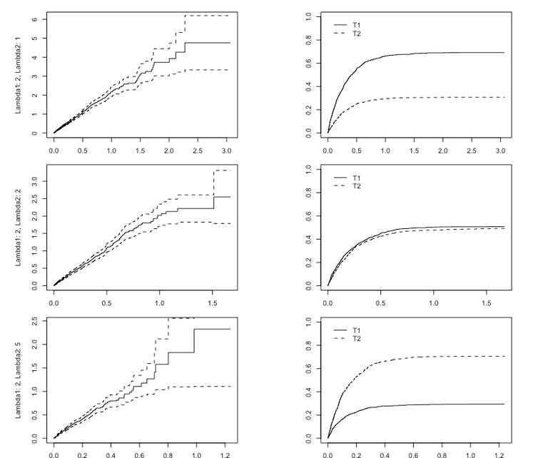
Quantitative risk ASSESSMENT
This module introduces the concepts of quantitative risk assessment and associated metrics

Slide 4
Quantitative Risk Assessment (QRA)
Structured approach to assigning numerical values to risk components
Enables organizations can measure, compare, and prioritize risks with a degree of mathematical rigor
QRA attempts to answer three core questions
How likely is the risk?
Expressed in terms of probability, frequency and rate
How much loss will occur if it happens?
Expressed in terms of cost, damage, liability and downtime
What is the organization’s financial exposure?
Expressed as Annualized Loss Expectancy or equivalent
QRA attempts to model uncertainty using numbers instead of categories, aiming for greater objectivity and repeatability

Slide 5
Quantitative Risk Assessment (QRA)
Quantitative risk analysis typically uses the formula
Risk = Probability × Impact
Applied repeatedly over a one-year time horizon, this becomes
Annualized Loss Expectancy (ALE) = Single Loss Expectancy (SLE) × Annual Rate of Occurrence (ARO)
SLE = cost of one event
ARO = number of events per year (or expected frequency)
This is then scaled across multiple risks, scenarios, or systems

Slide 6
Quantitative Risk Assessment (QRA)
Key data sources include
Historical incident data (internal, industry, insurance)
Threat intelligence (malware trends, attack frequency)
Actuarial data (claims, premiums, event frequency distributions)
Benchmark studies (e.g., Ponemon, Verizon DBIR, Gartner)
Operational logs (system outages, fraud cases, processing errors)
Common statistical models
Monte Carlo simulation
Bayesian inference
Frequency-severity models
Regression forecasting

Slide 7
Validity
Does the quantitative model measure what it claims to measure?
Challenges with validity
Frequency data may not reflect true likelihood
For example: many cyber incidents go unreported or undetected
Loss data may be incomplete or inconsistent
For example: financial impact is often spread across departments
Benchmark data may not match the organization’s risk profile
For example: using Ponemon data for a small credit union
Improving validity
Use scenario-based modeling rather than relying solely on historical data
Employ expert judgment to adjust models where data is sparse
Validate assumptions by triangulating sources
For example: insurance claims, vendors, internal logs

Slide 8
Reliability
If we repeat the analysis, do we get the same result?
Reliability issues
Risk frequencies typically fluctuate year to year
Threat landscapes evolve quickly which means that past data may not predict future events
SMEs give inconsistent estimates when data is sparse.
Improving reliability
Use multi-year averages or parametric distributions instead of single values
Use data cleaning to remove outliers that will skew the predictions
Document assumptions to ensure repeatability
Apply automated statistical methods (e.g., Monte Carlo) to reduce human variability

Slide 9
Accuracy
How close are the estimated numbers to the true values?
True values are often unobservable, especially for rare events
The goal is often reasonable approximation, not perfect precision
Accuracy limitations
Rare or catastrophic risks (black swans) have almost no accurate data
Public reports often exaggerate or under report losses
Human estimation is error-prone. even when expressed numerically
Improving accuracy
Use wide ranges, not point estimates (e.g., $50k–$300k)
Apply repeated statistical simulations to generate a loss distribution
Combine internal and external data to reduce estimation variance

Slide 10
Strengths of QRA
Supports financial decision-making
Because QRA expresses risks in monetary terms, organizations can, for example
Compare cost of controls vs. expected losses
Justify cybersecurity budgets
Support insurance decisions
Inform strategic investment decisions
Enables advanced modeling
Monte Carlo and Bayesian techniques allow analysts to
Evaluate uncertainty
Simulate rare events
Model interdependent risks
Produce risk distributions rather than one-dimensional scores

Slide 11
Strengths of QRA
Reduces subjectivity
Numerical inputs minimize the ambiguity of qualitative scales like “High/Medium/Low”
Enables cost-benefit and ROI calculations
For example: ALE (before control) – ALE (after control) = Value of Control
Standardized and repeatable
Once a model is built, new data can be entered consistently over time
Supports benchmarking and regulatory reporting
Many frameworks (NIST CSF 2.0, FAIR, Basel II/III) rely heavily on quantitative risk data

Slide 12
Weaknesses of QRA
Data scarcity
Most organizations lack sufficient:
Loss data
Frequency data
Forensic records
Incident cost transparency
This can undermine accuracy and reliability
False precision
Numbers give an impression of certainty that usually does not exist.
For example: “Probability = 0.13” falsely suggests exactness.

Slide 13
Weaknesses of QRA
High reliance on assumptions may be more influential than the data itself
Assumptions about
Event frequency
Control effectiveness
Detection rates
Recovery times
Complex modeling may not be understood by decision makers
Executives may resist results they cannot interpret, especially Monte Carlo outputs.
Cannot capture qualitative factors well such as
Reputational damage
Regulatory backlash
Stakeholder trust
Organizational culture impacts

Slide 14
Weaknesses of QRA
Not ideal for entirely novel risks
Emerging technology risks (AI misuse, quantum threats) often have no associated data
Time-consuming
Building a reliable quantitative model requires:
Data collection
Data cleaning
Data validation
Data modeling
Stakeholder review
Qualitative methods are much faster

Slide 15
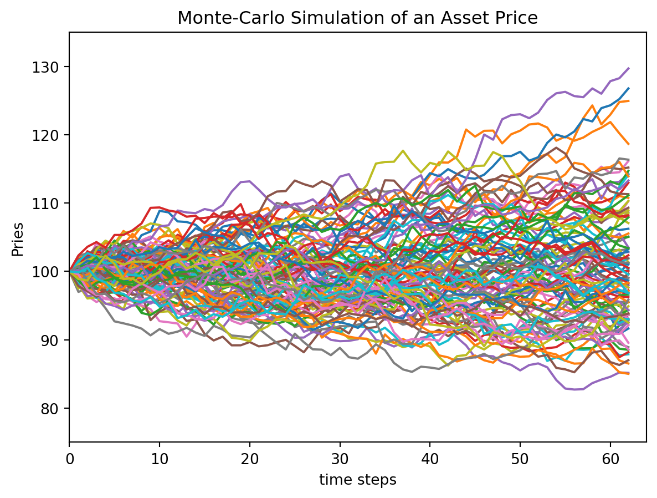
Monte Carlo Simulation
Runs thousands of iterations using ranges or probability distributions
Produces likelihood curves, heat maps, and loss distributions
Good for uncertainty and tail risk

Slide 16
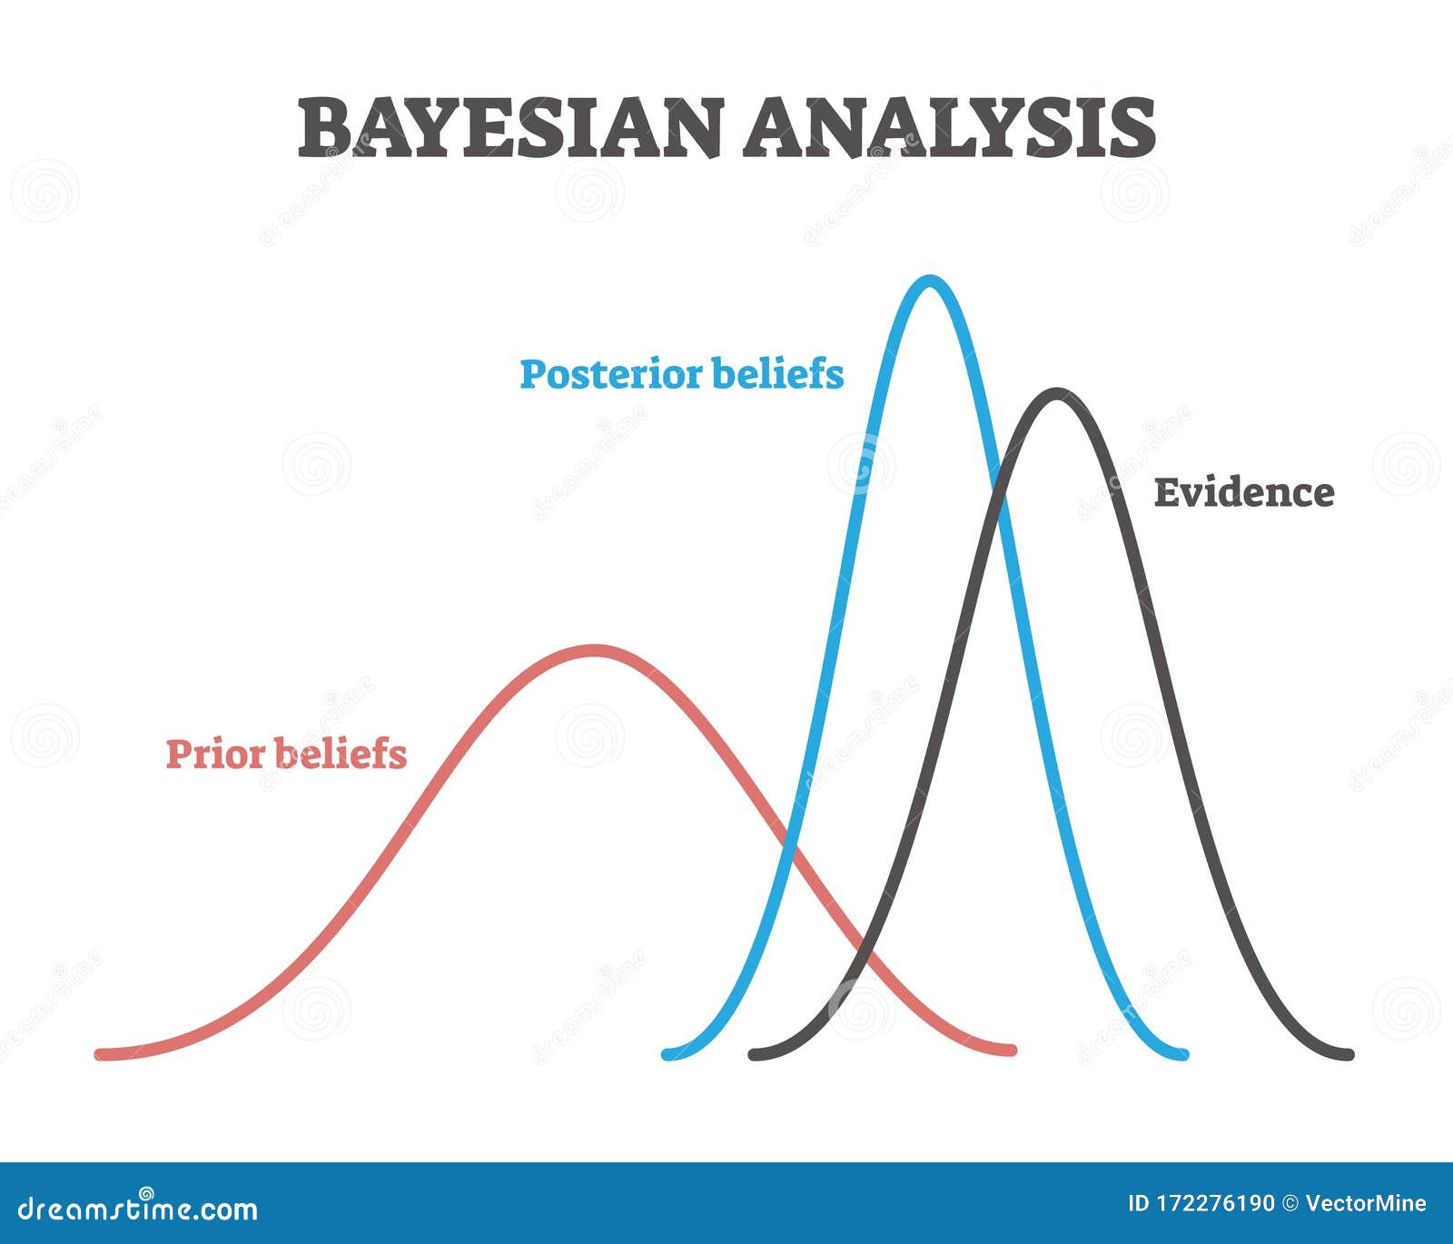
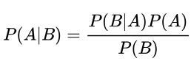
bayesian Simulation
Bayesian modelling represents unknown parameters as probability distributions (priors), observe data and update the priors to posterior distributions using Thomas Bayes’ theorem:
Key features:
Explicitly encode prior beliefs (or lack thereof) about parameters
Update beliefs in light of new data.
All parameters and predictions are treated probabilistically, not just point estimates

Slide 17
bayesian Simulation
Suitable for hierarchical models, uncertainty quantification, small-sample scenarios, and modelling complex structure
Strengths include
Better handling of uncertainty
Ability to incorporate prior knowledge, and natural fit with modern computational methods
Limitations include
Computational cost
Sensitivity to prior choices
Potential difficulty in interpretation for non-statisticians.

Slide 18
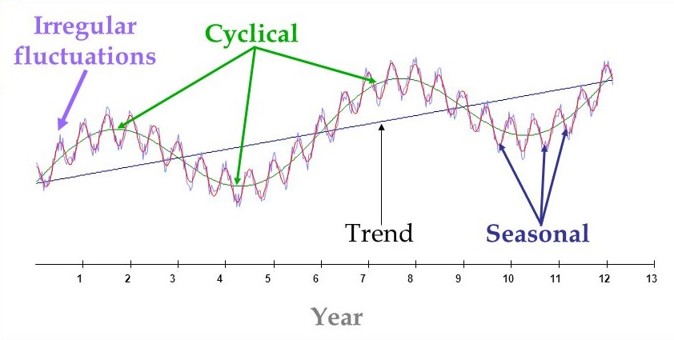
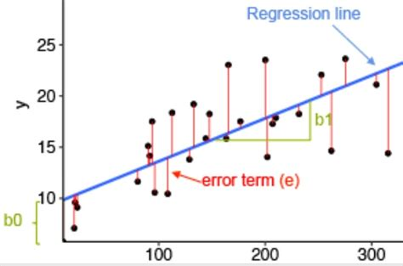
Regression and Time-Series
Predicts frequency/severity trends
A sequence of observations recorded at successive points in time
Example: daily stock prices, hourly sensor readings, monthly sales numbers, annual climate measurements, etc.
The central idea is that past patterns help explain or predict future behavior
Time series help identify long-term movements in data
Regression is used to fit a curve to existing data that can be used for future predictions

Slide 19
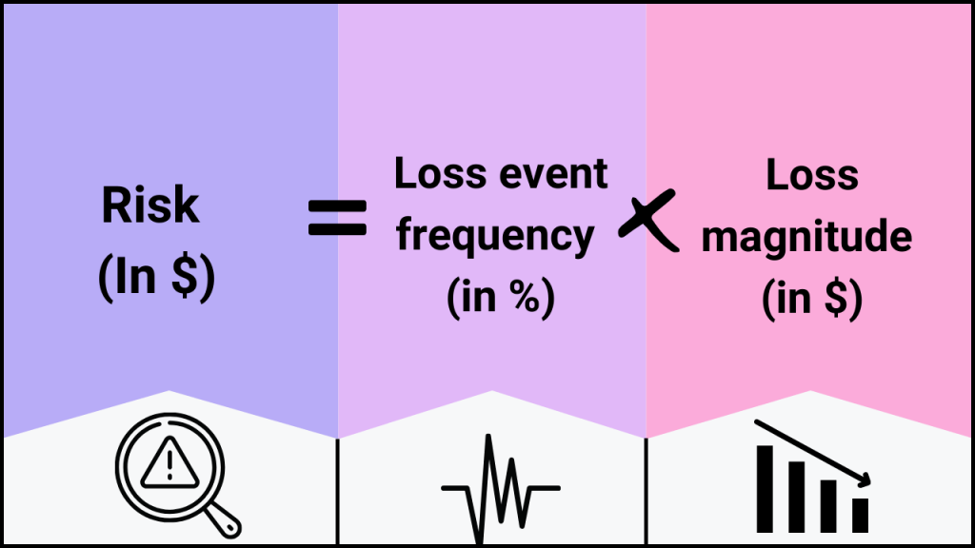
FAIR Model
Factor Analysis of Information Risk
Decomposes risk into frequency + magnitude components
Widely used in cybersecurity
Provides repeatable numerical estimates

Slide 20
When QRA Works Best
Quantitative methods excel when
A large volume of high-quality, consistent data exists
Risks have measurable financial impacts
The organization has mature incident reporting
The objective is budgeting, prioritization, or insurance
Top leadership prefers evidence-based decision-making
Ideal domains
Cybersecurity
Fraud and financial loss forecasting
Operational risk (Basel frameworks)
Business continuity and disaster recovery
Insurance and actuarial sciences

Slide 21
Integration
Most modern ERM programs use a hybrid approach
Qualitative to identify and explore risks
Quantitative to measure and justify decisions
Scenario analysis to fill gaps where data is scarce
Dashboards combining both for executives

Slide 22
Standard Quantitative Risk Metrics
Single Loss Expectancy (SLE)
SLE estimates the financial loss from a single occurrence of a risk event.
Formula: SLE = Asset Value (AV) × Exposure Factor (EF)
AV = monetary value of the asset
EF = % of the asset lost in the event (0–1)
Example
Asset value: $500,000
Exposure factor: 0.25 (25% damage)
SLE = 500,000 × 0.25 = $125,000

Slide 23
Standard Quantitative Risk Metrics
Annualized Rate of Occurrence (ARO)
Represents how often an event is expected to occur per year.
Sources for ARO:
Historical logs
Industry databases (ISACA, Ponemon, Verizon DBIR)
Threat modeling
Expert estimation
Statistical frequency data
Example
If phishing incidents occurred 10 times in 5 years:
ARO = 10 / 5 = 2
Expect 2 phishing events per year.

Slide 24
Standard Quantitative Risk Metrics
ALE estimates annual financial loss due to a given risk.
Crucial for comparing the cost of mitigation vs. expected loss.
Formula: ALE = SLE × ARO
Example
SLE = $125,000
ARO = 0.5 (every two years)
ALE = 125,000 × 0.5 = $62,500 per year

Slide 25
Qualitative vs. Quantitative
Risk assessment methods fall on a spectrum from qualitative to quantitative
Each approach has strengths, weaknesses, and preferred use cases
Modern Enterprise Risk Management (ERM) frameworks increasingly leverage hybrid approaches that combine the advantages of both

Slide 26
Qualitative Risk Assessment
Uses descriptive, non-numeric scales to evaluate likelihood, impact, and priority
Relies heavily on expert judgment, interviews, and subjective evaluations
Characteristics
Uses words or discrete categories (e.g., low, medium, high)
Often includes ordinal scales (e.g., 1–5), risk matrices, and heat maps
SME input is central to identifying emerging risks, understanding context, and assessing controls
Useful when numerical data are scarce or uncertainty is high

Slide 27
Qualitative Risk Assessment
Strengths
Fast and easy to perform
Works well with ambiguous, emerging, or strategic risks
Encourages discussion among stakeholders and SMEs
Helps uncover hidden issues and process weaknesses
Minimal data requirements.

Slide 28
Qualitative Risk Assessment
Limitations
Highly subjective
Influenced by cognitive biases (anchoring, availability, groupthink)
Inconsistent results across teams, interviews, or time periods
“High/Medium/Low” categories oversimplify uncertainty
Heat maps can create false precision or distort comparisons
Difficult to justify risk decisions to regulators, auditors, or executives seeking numeric analysis

Slide 29
Qualitative Risk Assessment
Best use cases
Early-stage risk identification
Strategic, reputational, cultural, or political risks
Areas with incomplete or low-quality data
Rapid assessment workshops or preliminary scans

Slide 30
Quantitative Risk Assessment
Assign numeric values to likelihood and impact and use mathematical models to estimate financial exposure
Characteristics
Uses probability values, frequencies, ranges, and distributions
Produces monetary loss estimates (e.g., ALE = ARO × SLE)
Incorporates statistical techniques such as Monte Carlo simulation, Bayesian models, and regression
Draws from loss data, benchmarks, actuarial sources, and threat intelligence

Slide 31
Quantitative Risk Assessment
Strengths
Produces replicable, evidence-based results
Enables financial decision-making (ROI on controls, capital planning, insurance)
Quantifies uncertainty using ranges and distributions
Supports advanced modeling of rare/complex events
Critical for operational risk, cyber risk, and enterprise decision-making

Slide 32
Quantitative Risk Assessment
Limitations
Requires high-quality, consistent data is often missing
Can create false precision (“probability = 0.23”)
Dependent on assumptions and model calibration
Computationally and conceptually more complex for stakeholders
Not ideal for emerging risks with no historical data

Slide 33
Quantitative Risk Assessment
Best use cases
Financial, cyber, and operational risk
Cost-benefit analysis of controls
Capital adequacy / reserve calculations
Insurance underwriting
Strategic budgeting and scenario analysis

Slide 34
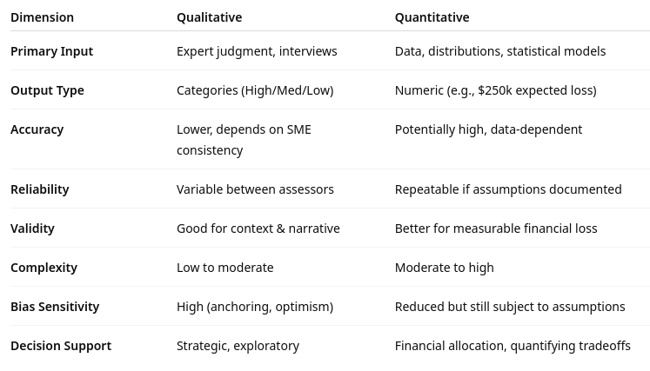
comparison

Slide 35
Hybrid Risk Assessment
Combine strengths of both qualitative and quantitative methodologies
Produces a balanced, defensible, and flexible risk analysis
Increasingly popular in ERM, cyber risk, and operational risk programs
Why hybrid approaches are used
Qualitative methods provide context and identification
Quantitative methods provide measurement and justification
Many risks require both narrative context and financial modeling
Data may be available for some components but not others
Hybrid methods allow analysts to blend SME insight with data-driven rigor

Slide 36
Types of Hybrid Approaches
Qualitative identification followed by quantitative measurement
The most common approach
Steps:
SMEs identify risks through interviews/workshops
Analysts quantify key risks using QRA models
Leadership receives both descriptive and numeric insights.
Example: ERM programs prioritizing top 10 risks for capital planning

Slide 37
Types of Hybrid Approaches
Quantitative inputs embedded in qualitative models
A qualitative heat map supplemented with:
Actual loss data
Industry benchmarks
Threat intelligence
Control failure rates
Improves validity but keeps the model simple for executives
Example: Cyber risk dashboards in IT governance

Slide 38
Types of Hybrid Approaches
Weighted scoring models (semi-quantitative)
Ordinal scales are assigned numeric values but weighted:
Likelihood scored 1–5
Impact scored 1–5
Weighted using factors (e.g., 30% frequency, 70% magnitude)
Not fully quantitative, but offer more granularity than pure qualitative methods
Example: Operational risk committees comparing non-financial risks

Slide 39
Types of Hybrid Approaches
Bayesian/Monte Carlo overlays
SME judgments are converted into probability ranges rather than categories
Then used in quantitative models
Example:
SME belief a risk is “likely” is mapped to a probability distribution of 0.3–0.6
Monte Carlo simulation produces a distribution of expected loss.
Example: Cybersecurity, insurance, business continuity simulations

Slide 40
Types of Hybrid Approaches
FAIR-based hybrid models
FAIR decomposes qualitative SME insights into quantitative elements:
Threat event frequency
Vulnerability
Loss magnitude
Control strength
SMEs give ranges; models convert them to distributions
Example: Quantifying cyber risks where data is sparse but SMEs have rich contextual knowledge

Slide 41
Strengths of Hybrid Approaches
Balanced: context + numbers
Provides rich narrative and measurable evidence
Flexible with data availability
Works with both robust datasets and SME estimates
Reduced bias
Quantitative elements counterbalance SME subjectivity
Better stakeholder communication
Qualitative summaries for executives, quantitative details for analysts
High validity and reliability when designed well
Cross-verification strengthens the final result

Slide 42
Weaknesses of Hybrid Approaches
Potential inconsistency
Poorly integrated models can blend incompatible scales
Can become overly complex
More components mean heavier documentation and governance
Requires multidisciplinary skill sets
Analyst must understand psychology, qualitative interviewing, and statistics
Risk of double counting
Mixing multiple inputs can overweight certain variables

Slide 43

Q&A and open discussion
Notes:
Now is the time to engage in an interactive Q&A session where you can ask questions, share insights, and clarify any doubts about the topics we have covered so far.
This open discussion is designed to ensure that every participant has the opportunity to voice their thoughts and learn from the collective experience of the group.
Your questions and comments are valuable as they help us identify areas that may need further explanation and enable us to tailor future sessions to your needs.
We encourage you to speak up and contribute to the dialogue, as this interaction is one of the key components of our interactive learning approach.
As the session progresses, take note of any questions or ideas that you would like to revisit, and feel free to share your perspectives with the class.

